Slide 1
Information System Analysis & Design
‘REPAIR-MADE-EASY(RME) INFORMATION SYSTEM’
Prepared By:
BISHAL BUDHATHOKI (12116421)
RABINA PRAJAPATI (12117176)
SAKAR SAINJU (12120342)
AJAY MALL (12123341)

Slide 2
Presentation Overview
Introduction
Existing system
Desired system
Key functional requirement
Prototype snapshots
Technology & tools used
Reflection and conclusion

Slide 3
Introduction
‘Repair-Made-Easy (RME) Inc’, a store located in the city of Melbourne, Australia.
The current system has many issues which needs to be resolved.
Provides spare parts and services
Manual process
No security
Lack of inventory awareness

Slide 4
Existing System
Manual processing
Lack of User dashboard
Human error
Customers are unable to track their orders.
Difficulties if scale up when business grows.

Slide 5
Desired System
Web-based
Centralized database
Customer can track their orders
Print/download invoices
Automated system

Slide 6
Key Functional Requirements
Admin handle all the process .
Customer can create and manage his/her profile.
Customer can order and track the product.
Employees can view the daily transactions and customer’s order
Employees can track the stock in the inventory and can the product from the suppliers.

Slide 7
Critical Use Cases
User Registration
Login/Logout
Print/Download transactions
Print/Download Consolidated orders
Track orders from suppliers
View Previous order details
Generate invoices
Update Personal Information
Online Payments

Slide 8
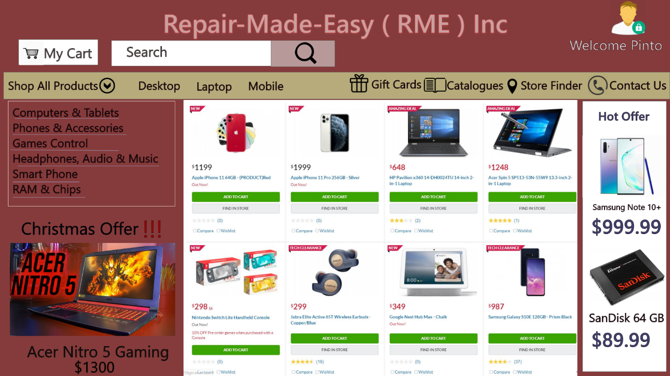
Home Page
The given snapshot indicates the home page for the customers where they can see products.

Slide 9
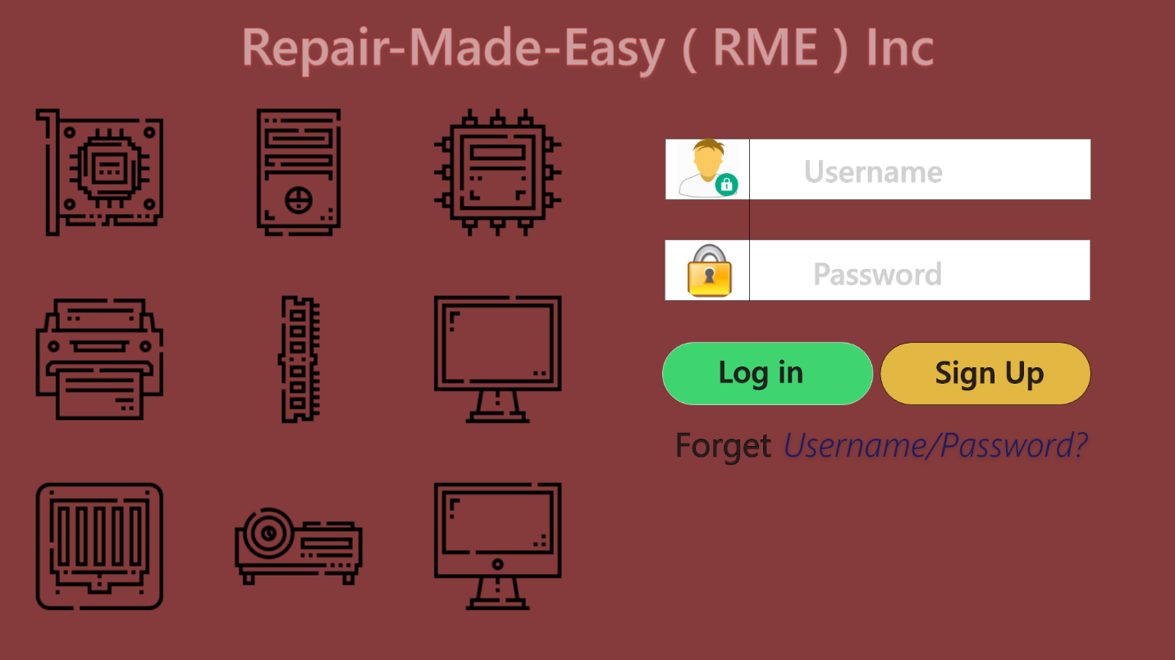
Sign in Page
The Following snapshot indicates the login page for the patrons.

Slide 10
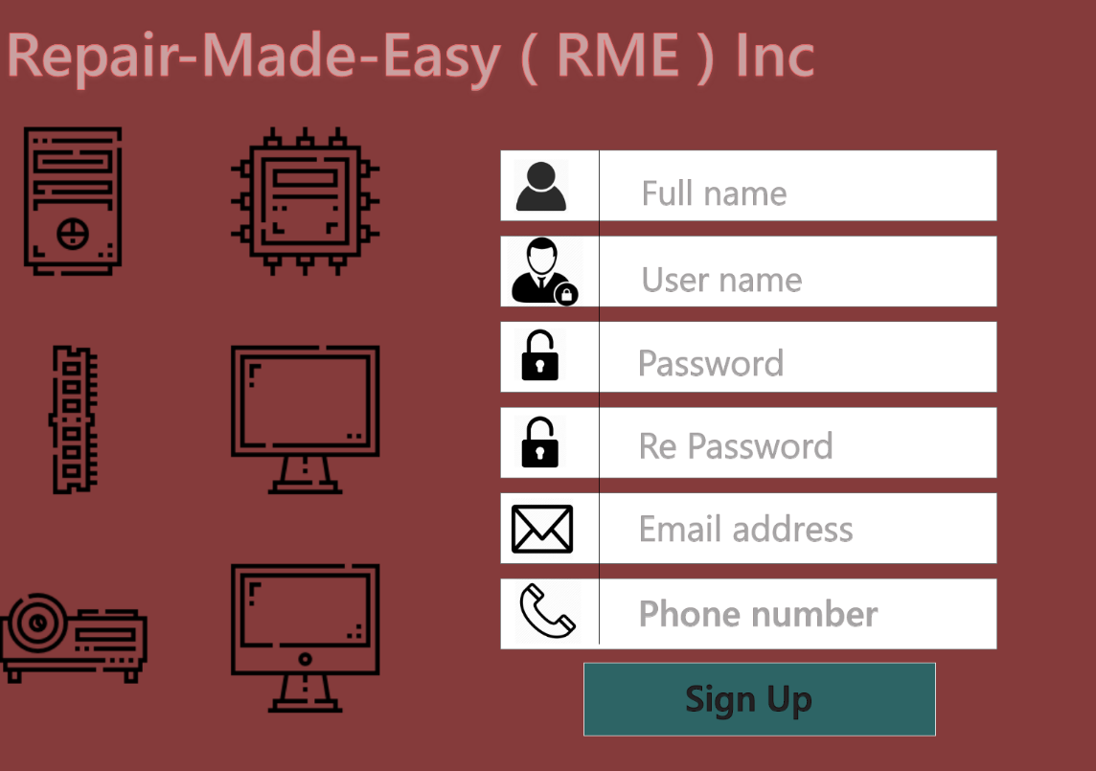
Sign up Page
The given snapshot indicates the sign up page for the patrons.

Slide 11
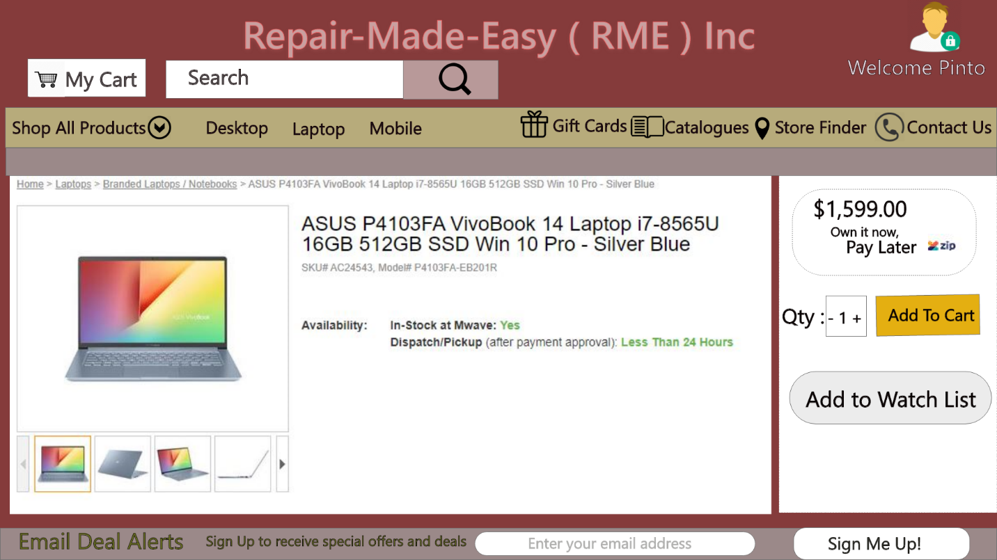
Product Page
The below snapshot indicates the product page from where the customer can order online.

Slide 12
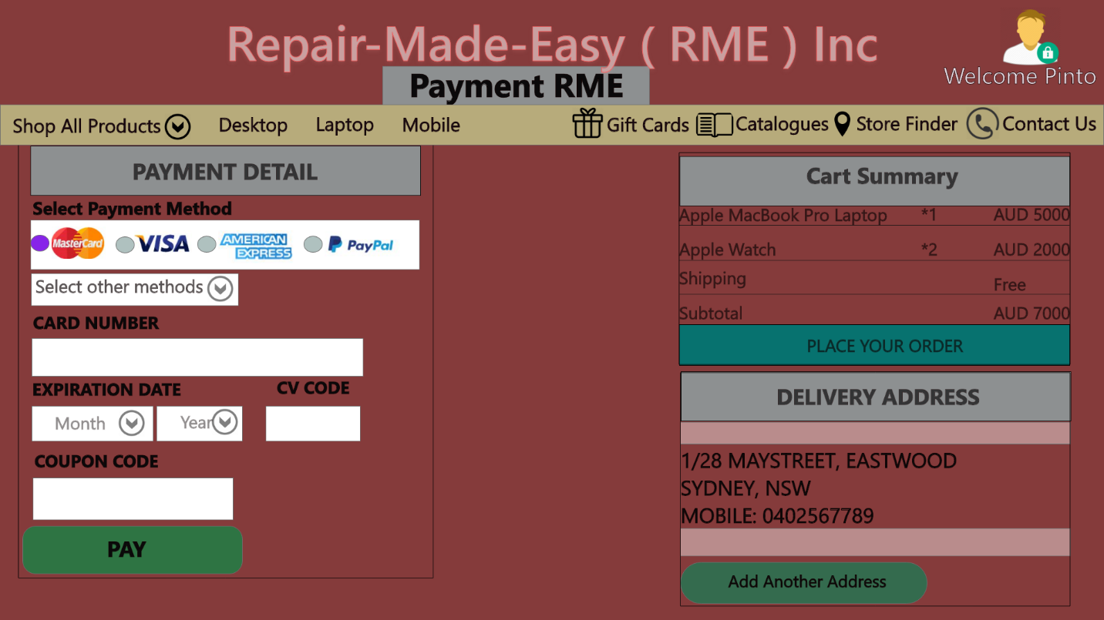
Payment Page
The below snapshot indicates the ongoing payment process.

Slide 13
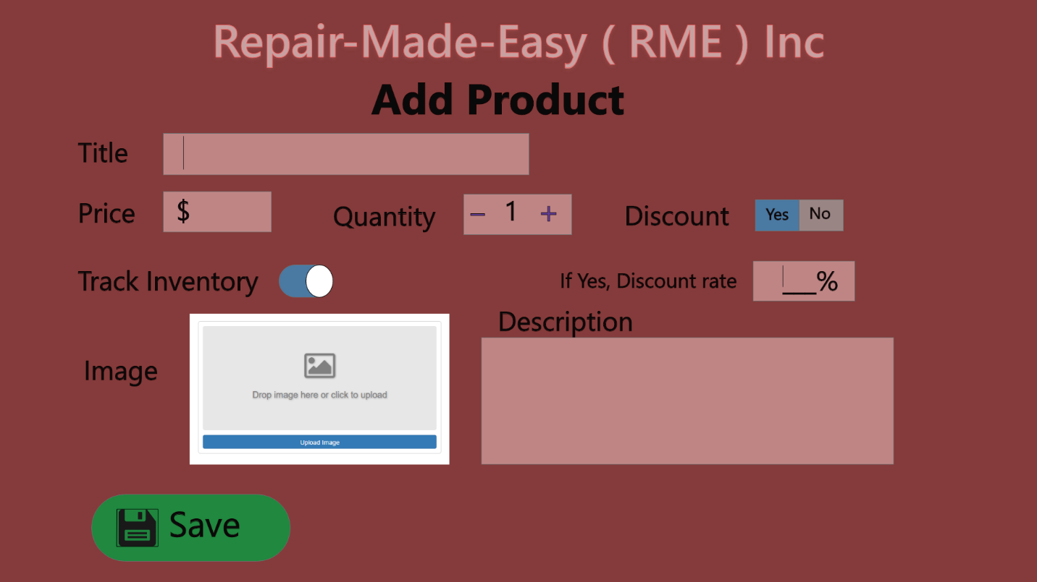
RME- Add Product Form
The following snapshot represents the add new product form this will be fill by employee.

Slide 14
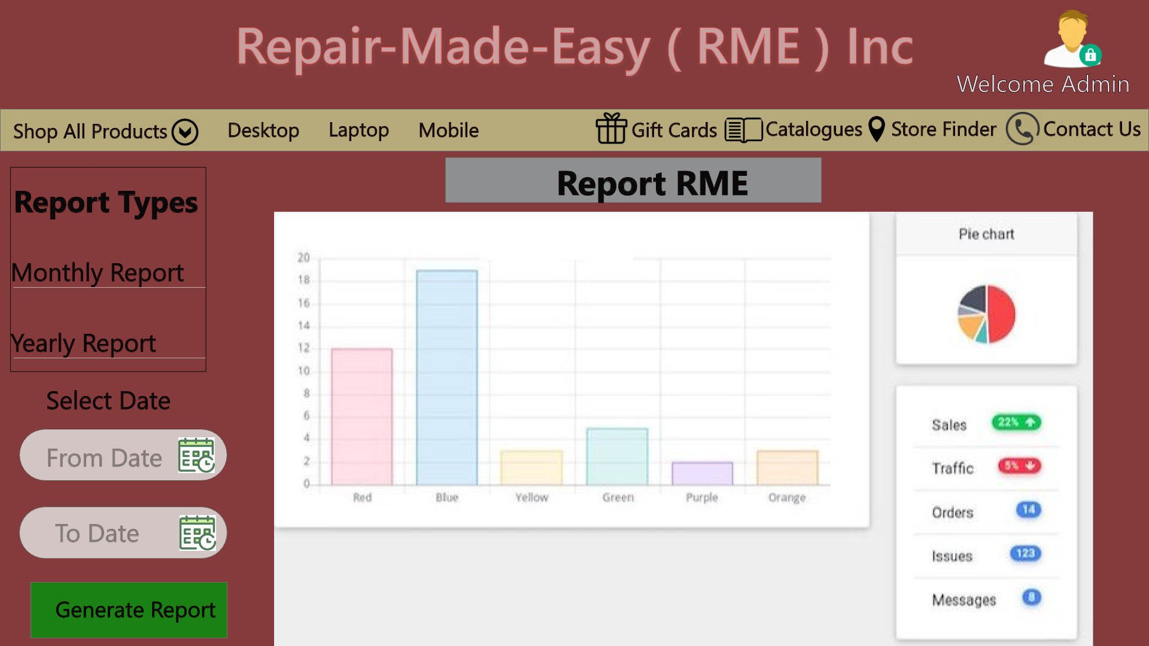
Report Page
The below snapshot is the report page for the transactions.

Slide 15
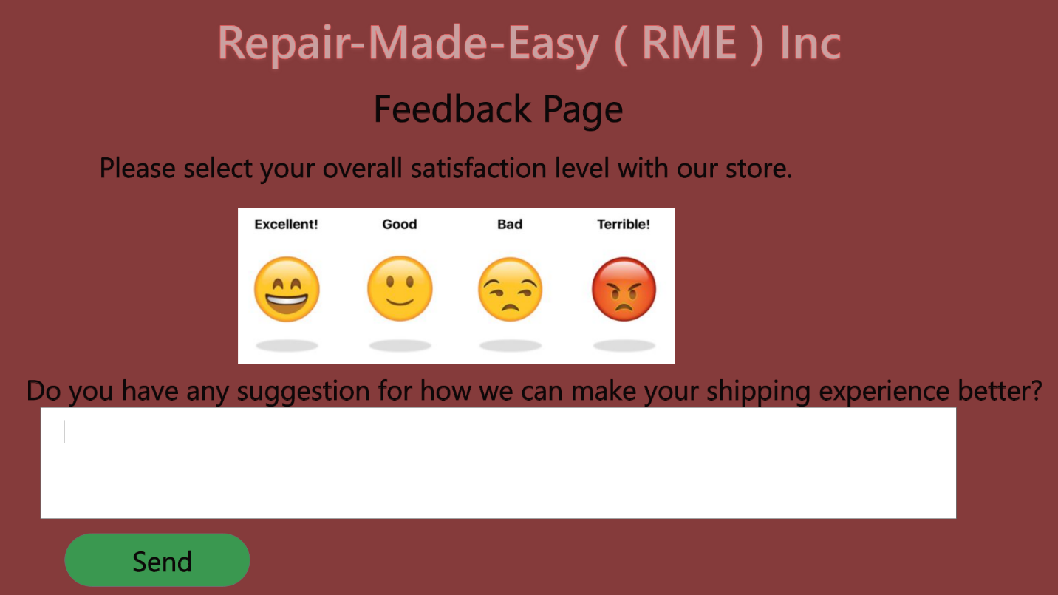
Feedback Page
The below snapshot represents the feedback of the service from the RME Information system.

Slide 16
Tools & Technology Used
Adobe XD
Microsoft Visio 2016
MS Word and MS PowerPoint

Slide 17
Conclusion

Slide 18
References
Adams, C, n.d, ‘What is Context Diagram and What are the benefits of creating one?’, viewed 30 September 2019, https://www.modernanalyst.com/Careers/InterviewQuestions/tabid/128/ID/1433/What-is-a-Context-Diagram-and-what-are-the-benefits-of-creating-one.aspx
Lucidchart, n.d, Context Data Flow Diagram Template, viewed 30 September 2019, https://www.lucidchart.com/pages/templates/data-flow-diagram/context-data-flow-diagram-template
Arthur M. Langer, Analysis and Design of Information Systems, Third Edition, Springer-Verlag London Limited 2008
2015, ‘Use Case Diagram Guidelines for Better Use Cases’, Creately, viewed 01 October 2019, http://creately.com/blog/diagrams/use-case-diagram-guidelines
‘What is a Data Flow Diagram’, Lucid Chart, viewed 01 October 2019, https://www.lucidchart.com/pages/data-flow-diagram

Slide 19
Any Questions?

Slide 20
Thank You

